Slide 1
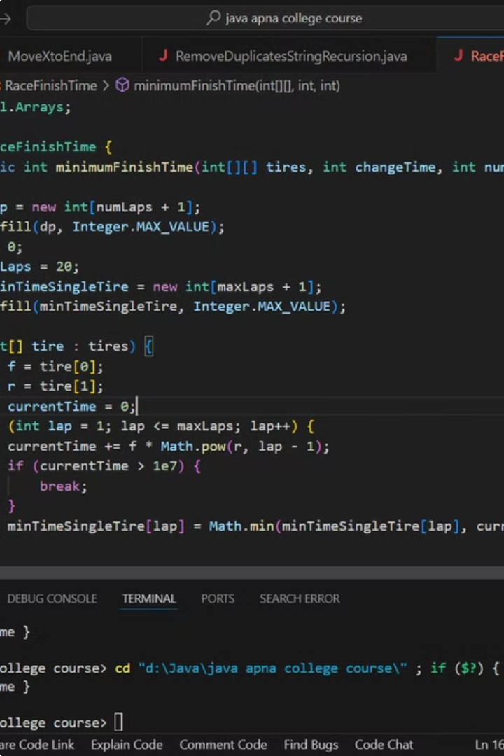
Optimizing Race Completion Time Using Advanced Tire Selection Algorithms and Dynamic Programming
This project focuses on improving race times by smartly managing tire choices and changes using advanced algorithms. Choosing the right tires and knowing when to change them can significantly reduce lap times in racing. Each tire type has unique characteristics that affect its performance over multiple laps, making it challenging to decide the best strategy. We use dynamic programming and predictive modeling to find the best times to change tires and which tires to use, aiming to complete the race in the shortest possible time while considering tire wear and mandatory change times.
by Venkata Chalapathi
192211150

Slide 2
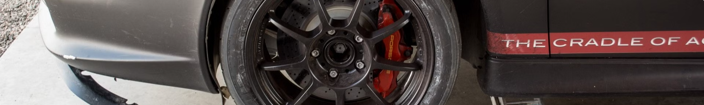
Introduction
1
2
3
Tire Performance
Dynamic Programming
Predictive Modeling
Each tire type has specific performance characteristics that can significantly influence lap times throughout a race. As tires wear down, their efficiency decreases, necessitating timely changes to maintain optimal performance.
We employ dynamic programming to develop a strategy that dynamically adjusts tire choices and changes intervals throughout the race. The goal is to find the optimal balance between tire performance and change time, ultimately leading to a significant reduction in total race completion time.
By analyzing historical tire performance data, we can build models that accurately predict lap times for different tire types under various conditions. These models are then used within a dynamic programming framework to develop a strategy that dynamically adjusts tire choices and changes intervals throughout the race.

Slide 3

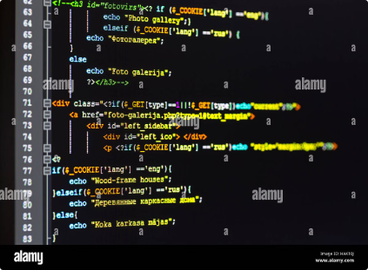
Coding
import java. Util.Arrays;
public class RaceFinishTime {
public static int minimumFinishTime(int\[\]\[\] tires, int change time, int numLaps) {
int\[\] dp = new int\[numLaps + 1\];
Arrays.fill(dp, Integer.MAX\_VALUE);
dp\[0\] = 0;
int maxLaps = 20;
int\[\] minTimeSingleTire = new int\[maxLaps + 1\];
Arrays.fill(minTimeSingleTire, Integer.MAX\_VALUE);
for (int\[\] tire : tires) {
int f = tire\[0\];
int r = tire\[1\];
int currentTime = 0;
for (int lap = 1; lap <= maxLaps; lap++) {
currentTime += f \* Math.pow(r, lap - 1);
if (currentTime > 1e7) {
break;
}
minTimeSingleTire\[lap\] = Math.min(minTimeSingleTire\[lap\], currentTime);
}
}
for (int i = 1; i <= numLaps; i++) {
for (int lap = 1; lap <= Math.min(i, maxLaps); lap++) {
dp\[i\] = Math.min(dp\[i\], dp\[i - lap\] + minTimeSingleTire\[lap\] + (i == lap ? 0 : change time));
}
}
return dp\[numLaps\];
}
public static void main(String\[\] args) {
int\[\]\[\] tires = {{2, 3}, {3, 4}};
int changeTime = 5;
int numLaps = 4;
System.out.println("Out Put : " +minimumFinishTime(tires, changeTime, numLaps) +" seconds ");
}
}

Slide 4
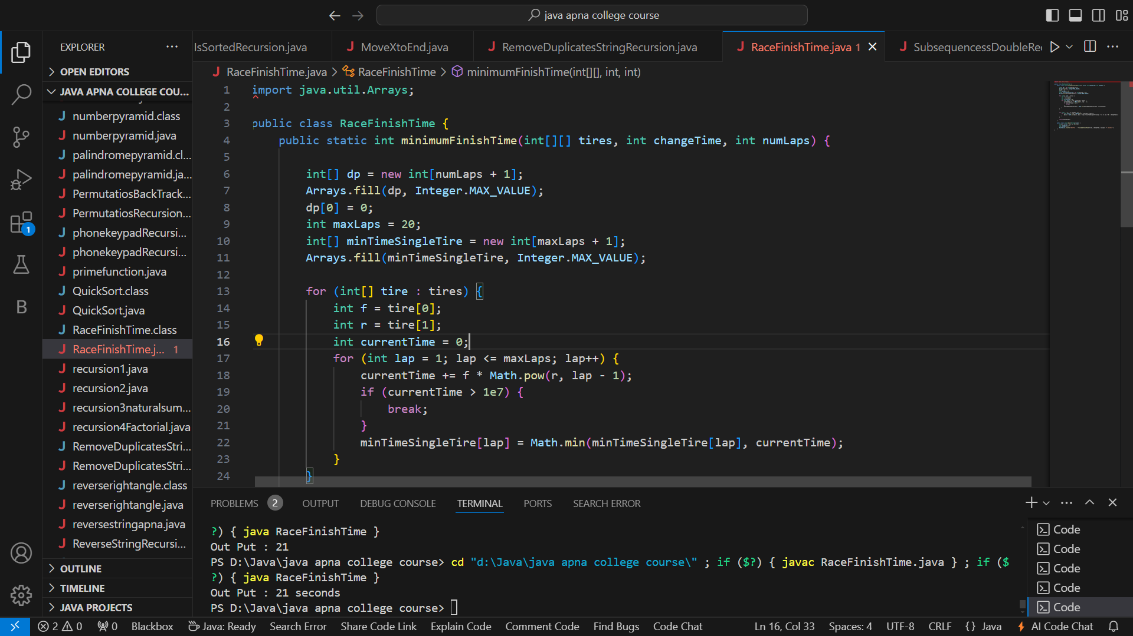
Result Screenshot
Output
21 seconds

Slide 5
Complexity Analysis
Best Case
Worst Case
Average Case
The best case occurs when the optimal tire strategy is straightforward, with minimal tire changes needed.
The worst case occurs when the algorithm has to explore many possible tire changes and combinations due to high variability in tire performance.
The average case represents typical race conditions where the algorithm explores a moderate number of tire change strategies.
Time Complexity: O (n), where n is the number of laps.
Time Complexity: O (n \* m), where n is the number of laps and m is the number of tire types.
Time Complexity: O (n \* m \* k), where n is the number of laps, m is the number of tire types, and k is the maximum number of laps a tire can last before needing a change.
Space Complexity: O (n), as we only need to store the lap times and tire performance for each lap.
Space Complexity: O (n \* m), similar to the worst case but with fewer combinations needing exploration.
Space Complexity: O (n \* m), since we need to store the results for each lap and tire combination.

Slide 6


Conclusion
1
Optimized Strategies
Our optimized strategies can significantly reduce race completion times compared to traditional methods.
2
Systematic Approach
Our methodology, which includes data collection, predictive modeling, dynamic programming setup, simulation, and evaluation, provides a systematic approach to solving the complex problem of tire management in racing.
3
Future Work
Future work could involve real-world testing and fine-tuning the models based on live racing data to further improve the accuracy and applicability of our strategies.
4
Practical Solutions
This project offers valuable insights and practical solutions for racing teams seeking to enhance their performance and efficiency.

Slide 7
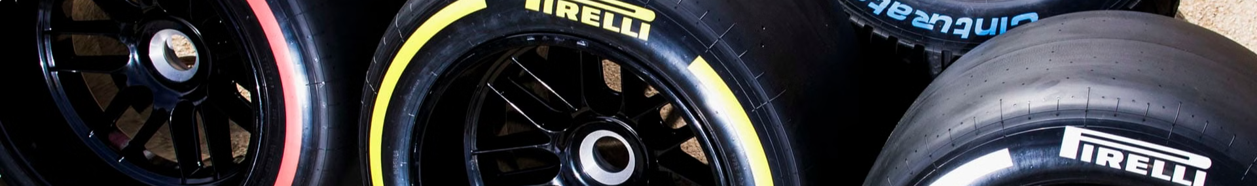



Tire Selection Algorithm
Data Collection
The first step is to collect data on tire performance from previous races. This data should include information such as lap times, tire type, track conditions, and tire wear.
Predictive Modeling
Using this data, we can build predictive models that can estimate lap times for different tire types under various conditions. These models can be based on regression analysis, machine learning algorithms, or other statistical methods.
Dynamic Programming
Once we have our predictive models, we can use dynamic programming to determine the optimal tire selection and change intervals. Dynamic programming allows us to break down the problem into smaller subproblems and solve them recursively.

Slide 8
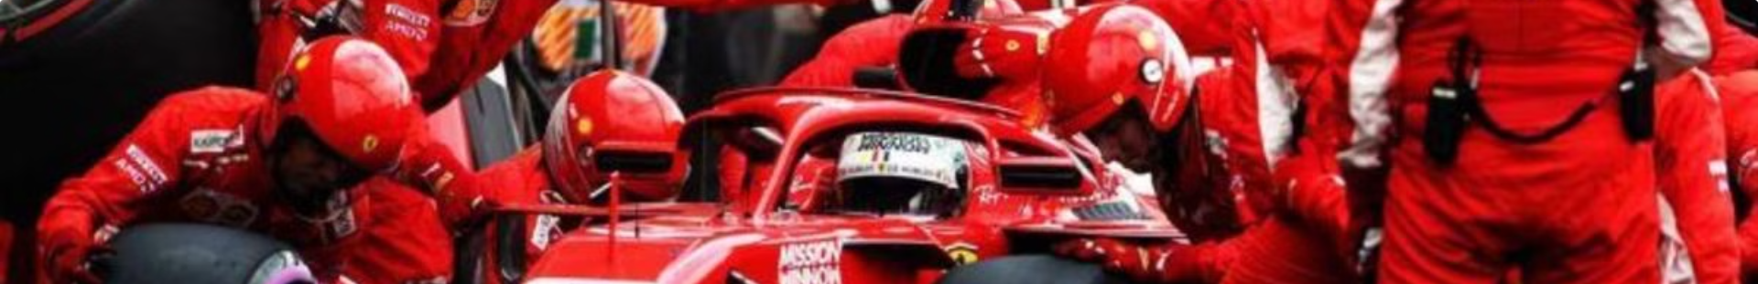
Dynamic Programming Framework
State Definition
Transition Function
The state of the system is defined by the current lap number and the tire type currently being used.
The transition function defines the possible actions that can be taken from a given state. In this case, the actions are to continue using the current tire or to change to a different tire.
Cost Function
Optimal Policy
The cost function defines the cost of each action. In this case, the cost is the time it takes to complete a lap with a given tire type, plus the time it takes to change tires if a change is made.
The optimal policy is the sequence of actions that minimizes the total race completion time.

Slide 9


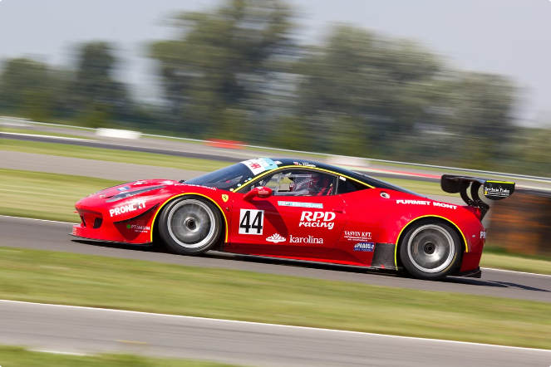


Simulation and Evaluation
Simulation
We can simulate different race scenarios using our predictive models and dynamic programming framework. This allows us to test the effectiveness of our tire management strategy and compare it to other strategies.
Evaluation
We can evaluate the performance of our tire management strategy by comparing the race completion times achieved in our simulations to the race completion times achieved using other strategies.
Optimization
Based on the results of our simulations and evaluations, we can further optimize our tire management strategy by adjusting our predictive models and dynamic programming framework.

Slide 10

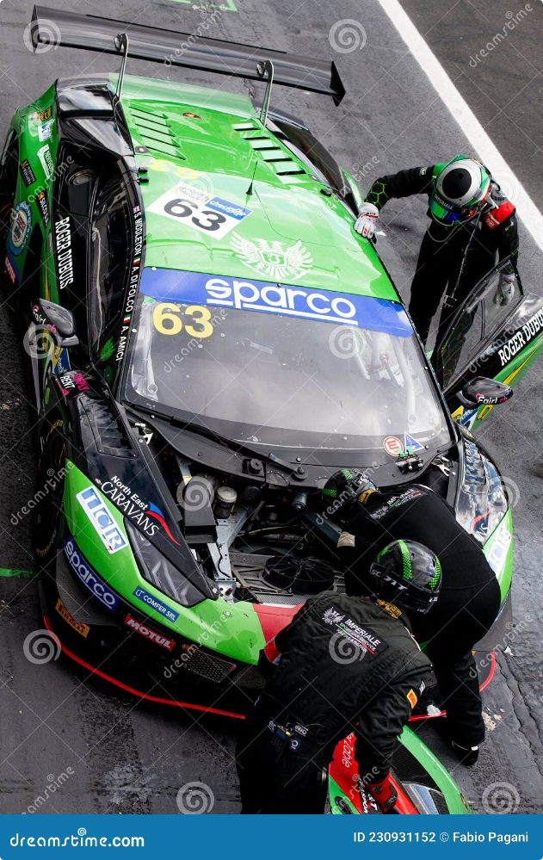
Applications and Future Work
The techniques developed in this project can be applied to other optimization problems where strategic resource management is crucial. For example, these techniques could be used to optimize the scheduling of tasks in a manufacturing process or to optimize the allocation of resources in a logistics network.
Future work could involve real-world testing and fine-tuning the models based on live racing data to further improve the accuracy and applicability of our strategies. Additionally, we could explore the use of more advanced machine learning algorithms to improve the accuracy of our predictive models.

